Slide 1
AuraDB Knowledge Graph Creation
Dāvis Palieks

Slide 2
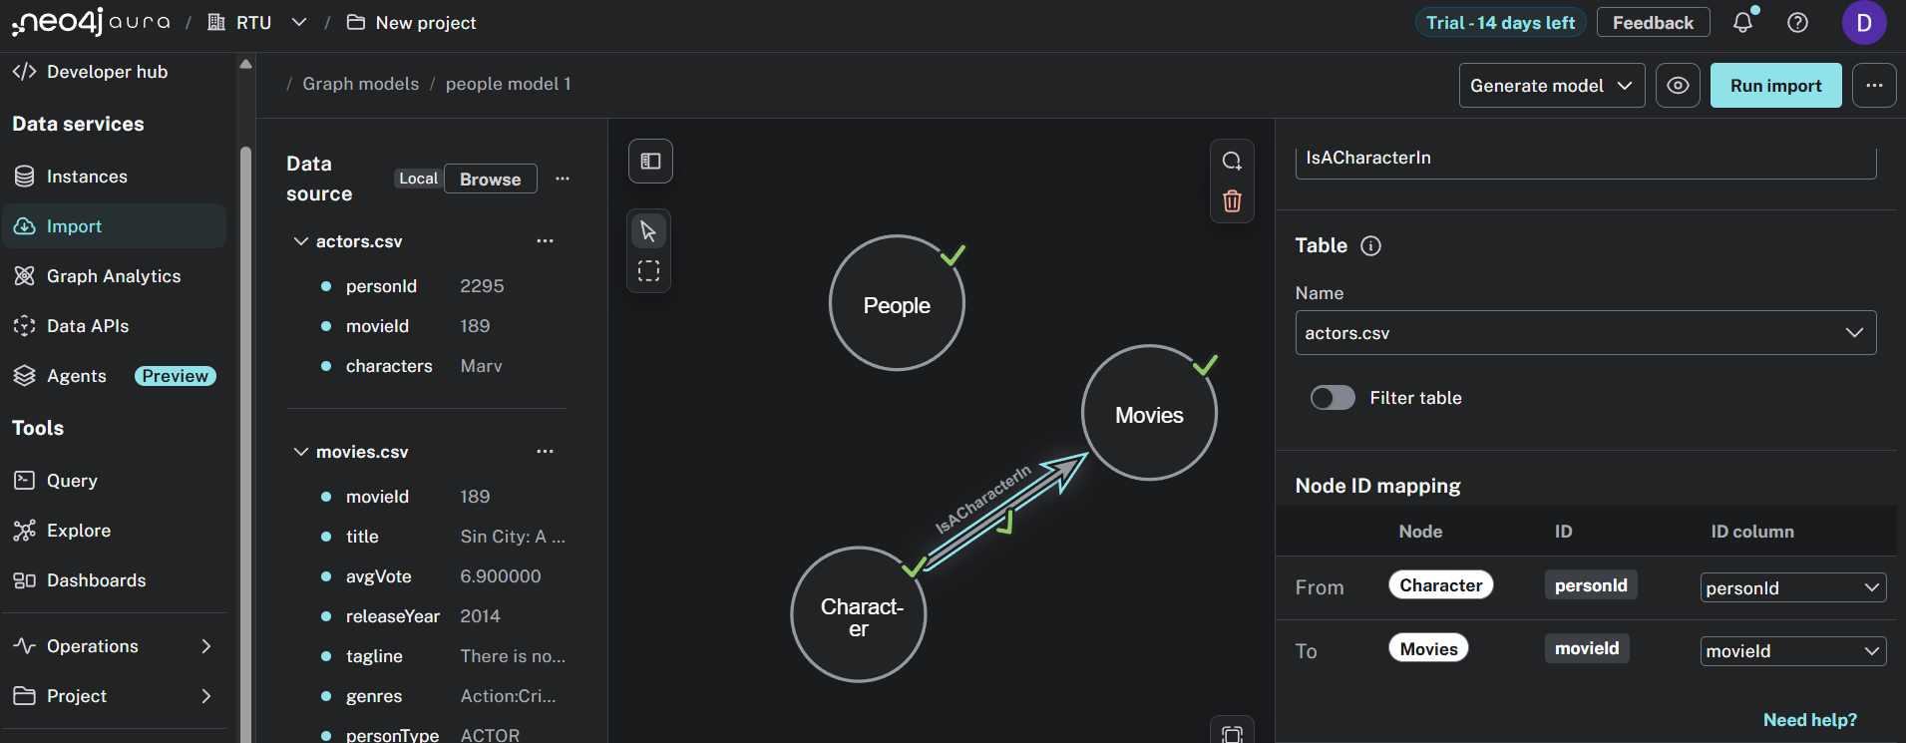
AuraDB Import/Schema

Slide 3
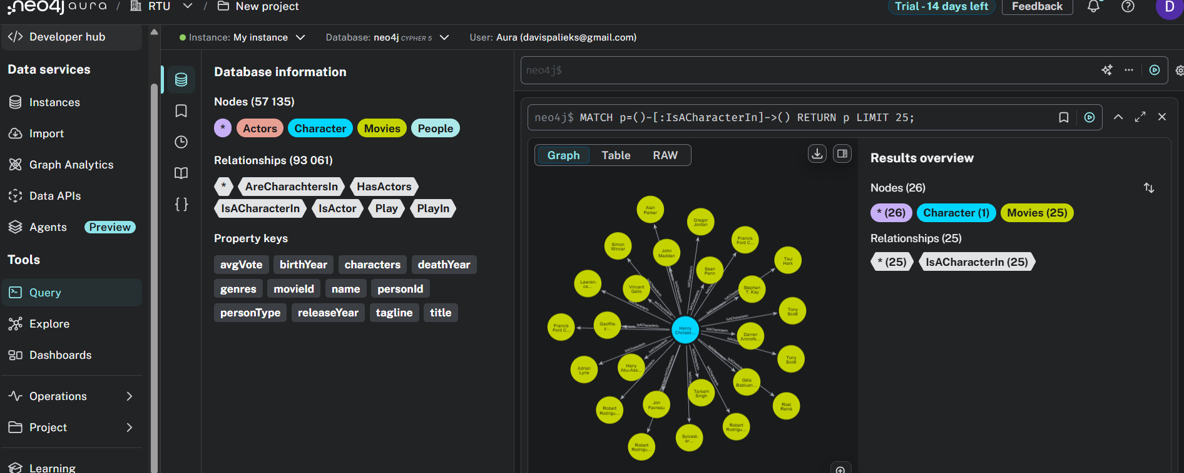
Query 1

Slide 4
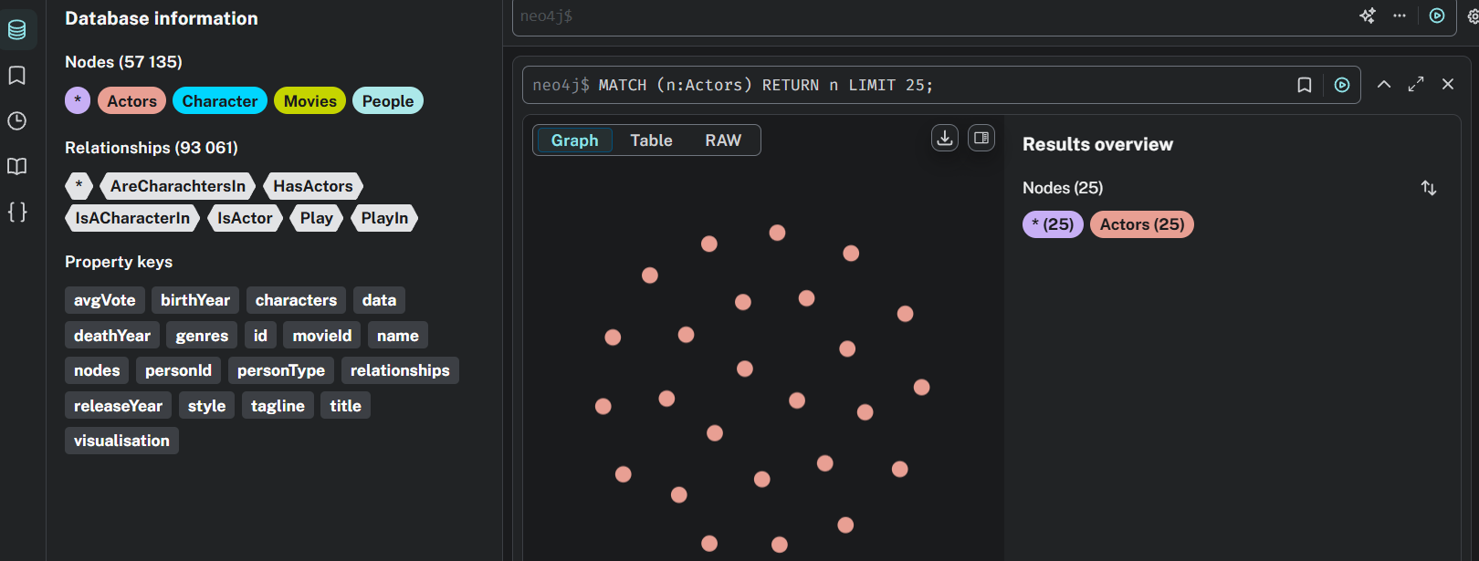
Query 2

Slide 5
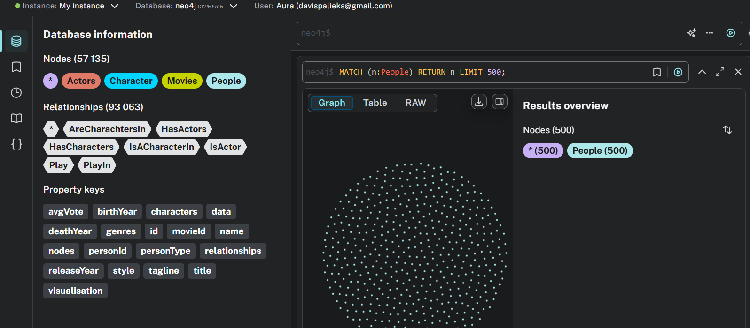
Query 3

